Slide 1
Storage
A Sharpe Curriculum

Slide 2
Storage is a big topic
We’ll brush on some important and very introductory parts but it’s so important and broad there are whole job titles dedicated to just storage. You’re single job title could be storage specialist.

Slide 3
Storage types
We will be talking about the following
File
Block
Object
Make sure to read this link on these three types.

Slide 4
File
The organized structure you’re used to
Has directories, files which we can access and human readable names
Key: If we use a service/protocol we can have multi-access to allow more than one access to the filesystem. Example: Samba or NFS

Slide 5
Block
-Filesystems determine a block size
-Ext4 is 4KB block sizes which supports 1 exabyte volumes and 16TB file sizes
Files larger than 4KB must get stored in multiple inodes

Slide 6
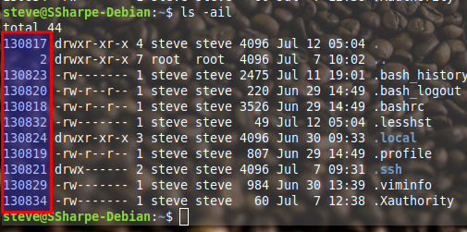
Block
Highlighted portion are the inodes, which is an index node

Slide 7
Block
To see the inodes add the switch -i to ls.
In the example I used ls -ail
-a all files (include hidden)
-i inodes
-l list format

Slide 8
Block
-If a file is 4KB or less the inode value in the listing is the one and only inode
-If a file is greater than 4KB the inode value is start of the file and has a link to the next inode
-Note: inodes are not always contiguous

Slide 9
Block
Besides just data inodes contain metadata
-times of last change
-times of last access
-times of last modification
-mode (means permissions)
-owner

Slide 10
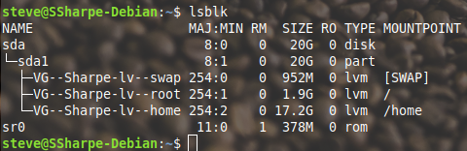
Block
Block devices: hard drives, cd-rom, USB storage, iSCSI, loop devices and a lot more

Slide 11
Decisions
You could use LVM as we did in our lab, see lsblk screenshot in the previous slide, or create a filesystem directly on the local partitions themselves.

Slide 12
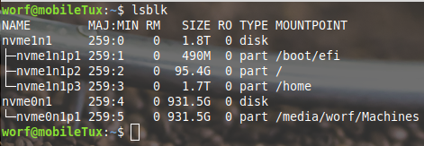
Decisions
An example of partitioning then writing the filesystem right to the logical volume.

Slide 13
Know your installation
Is this Linux installation on bare metal, or in a virtual machine?
Is this computer using directly attached storage or network storage?
Let’s look at some considerations of bare metal first

Slide 14
Bare metal
There are two choices that could exist
Computer could utilize RAID directly with directly attached storage
Could use network storage to a SAN which would use RAID
Unless the data is unimportant RAID will exist somewhere

Slide 15
Virtual machine
The machine that hosts the virtual machine would handle the data redundancy. Regardless if on bare metal or in a virtual machine we now need a discussion on write back to prevent data loss.

Slide 16
Performance!
I want the Lambo Huracán please
Systems default to write caching, which means in userland it appears the file was written but instead is queued for writing.
This gives the user extra performance at a cost.

Slide 17
Performance!
The problem with caching writes is on system failure. Power loss? Kernel panic? Any number of issues can cause a system to halt. If the system doesn’t have time to write the cache to disk you’ve experienced data loss.

Slide 18
Mitigations
For power loss providing battery power backup with a communication cable to the server to shutdown on power loss.
Disabling write backs
These decisions rest on how important the data is.

Slide 19
Levels of write caching
Write caching otherwise called write back could exist at the filesystem level, device mapper (in our case LVM!) and the disks itself
The opposite of write back is called write-through which writes directly to the disk

Slide 20
Device mapper
-It’s the magic or framework that connects physical block devices to virtual block devices
-This abstraction gives us the ability of:
- caching, encryption, snapshots, striping, mirroring, thin and a whole lot more

Slide 21
Device Mapper
If we were to encrypt an entire block device we would use dm-crypt for full disk encryption
For our lab we will be using LVM2 which uses device mapper as well

Slide 22
Logical Volume Manager (LVM)
Is an abstraction of the underlying physical drives utilizing the device mapper previously introduced.
Terms: physical volume, physical partition, volume group, logical volume, filesystem, mount point

Slide 23
Physical Volume
These are the hard drives that are physically attached to the computer. They’re all located under /dev

Slide 24

Physical Volume
This example sda (no number!) is the physical volume. This is on sata port 1. sdb would be sata port 2, etc, etc. Note the b in the mode, stands for block.

Slide 25
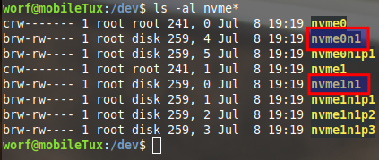
Physical partition
In this example nvme0n1 is the the first NVMe slot on this laptop and nvme1n1 is the second slot. More on NVMe in Linux

Slide 26
Physical partition
This step is still mandatory for both classic partitioning and using LVM. You can create a primary partition, extended partition and from there make multiple logical partitions.
Read about partitioning

Slide 27

Physical partition
In this example sda1 is the first partition on sda. Subsequent partitions would have been sda2, sda3, etc.

Slide 28
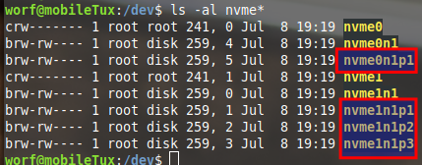
Physical partition
Partitions are nvme0n1p1, so the first NVMe drive has a single partition.
nvme1n1p1,nvme1n1p2,nvme1n1p3
Second drive has
3 partitions

Slide 29
Volume group
Don’t be confused by the naming. You add physical partitions but the commands are pv (physical volume). You must partition a volume (drive) to use for LVM

Slide 30
Volume group
A volume group is part of physical volumes. Once a physical volume has been added it has extents written across in chunks. This is completely filesystem agnostic.
Let’s see what the size of a “chunk” is

Slide 31
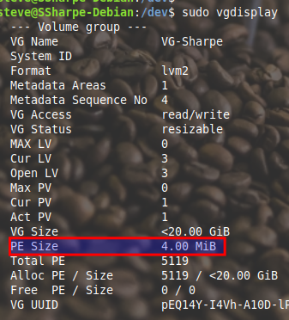
Volume group
PE is Physical extent is 4MB chunks
4*5119 extents is 20476MB or 20GB

Slide 32
Volume group - RAID
You can have tiers by having some groups protected by mirroring, parity and others without protection. Yes you read that right, LVM supports RAID out of the box. You need to meet the same requirements of a regular RAID by the minimum number of physical disks. Read how to implement RAID in LVM

Slide 33
Volume group - dm-cache
Caching typically involves combining slower HDDs with faster SSDs
Write-back will first write to SSD then slowly write to HDD when there is enough free I/O
Read-cache commonly read blocks get copied to SSD for faster reads (no risk here)

Slide 34
Logical volume
A volume group can make any number of logical volumes as long as there are free extents available. A single system can have multiple volume groups. Could have /guests with VMs backed by mirroring and a read cache and /isos with no protection nor cache.

Slide 35
Logical group - dm-cache
For logical volumes that need performance can enable caching through dm-cache.
Because RAID was at the group level you can have both RAID and caching if desired.

Slide 36
Logical volume - dm-cache
We discussed some risks with caching, but it however can be great performance. There are two types of caching
Write cache - write back
Read cache - commonly read blocks get cached

Slide 37
Filesystem
When you create a logical volume it comes with no filesystem. You could even use it for swap. To create a filesystem it’s the same whether on classical partitioning to sda1, sda2 etc or to a logical volume

Slide 38

Filesystem
If creating a filesystem on your logical volumes you can list their locations with lvscan.

Slide 39
Filesystem - resizing
Logical volumes can be either shrunk or grown to do so you’ll need to use resize2fs
If growing you run resize2fs after growing the partition, if shrinking it’s before removing extents.

Slide 40
Filesystems are wide ranging
There are numerous filesystems, the current version of ext is ext4 but there are other types that really depend on their use cases. Research use cases for: xfs and btrfs

Slide 41
Mount point
Once you have created the filesystem you’ll need to add a mount point to /etc/fstab so it will be available upon subsequent restarts

Slide 42
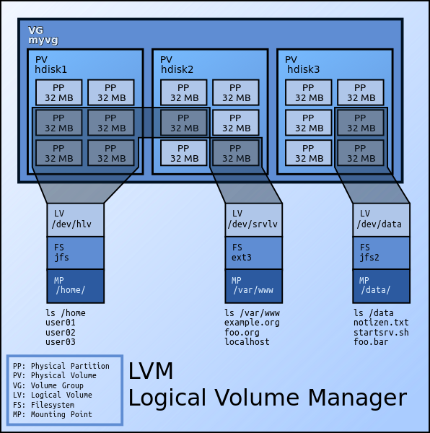
Example - source: Wikipedia

Slide 43
Features Snapshot
Using a feature called copy on write (COW) LVM supports snapshots. Most common use case for a snapshot is when you need to backup a live system. Imagine trying to capture a point in time backup of a system that is continuously changing through constant writes

Slide 44
Features Snapshot
Prior to performing a backup on a system it’s best practice to first take a snapshot. Once you take a snapshot it becomes a brand new device that is treated like an other regular logical volume, you simply mount the logical volume.

Slide 45
Features Snapshot
Once you have mounted the filesystem you can begin the backup process by either compressing the entire contents or select directories and copying the archive to: file storage (shared drive), tape or more recently object storage.

Slide 46
Features moving extents
Two common lifecycle of a hard drive
Begins to approach end of life
Management wishes to upgrade existing drives
Both cases we can easily replace drives with little to no downtime

Slide 47
Features moving extents
When installing a new drive using pvmove the extents can be moved from one drive to the other without taking the volume group offline. Once moved you may remove the old drive

Slide 48
Object
Usually cloud storage, you can however roll your own
If you require petabytes of storage
A replacement for tape backup for some organizations
Typically off site storage
Heavily distributed

Slide 49
Tape
-Easy to move off site without network access
-Still common today
-2021 Linear Tape-Open (LTO-9) stores 18TB per tape

Slide 50
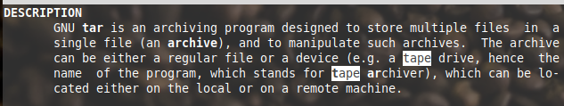
tar utility has tape in its name!
Tar stands for tape archiver

Slide 51
LVM for everything!
Not so fast. Read this clear warning.
LVM has its use cases. If on bare metal ease of resizing and hot swapping is useful but as a VM the hypervisors host takes care of those which mostly leaves snapshots for backups as a useful feature. When building systems plan accordingly!

